Slide 1

E- Learning Analytics
Our Team Members:
Chaitanya – Team Leader & Administrator
Hemanth –Backend Yashodhar – Database
Sai Hasini – Analysis
Harsha – Frontend

Slide 2

Problem Statement
Online learning platforms generate information about course enrolments, learner activities, and course completion. However, analysing this information manually can be difficult and time-consuming.

Slide 3
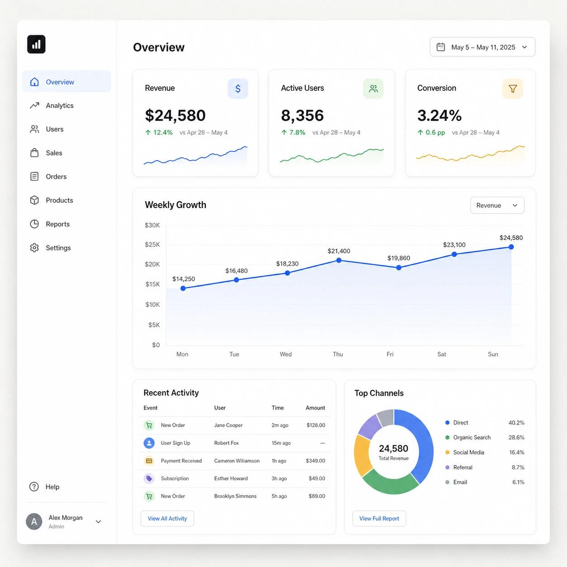
Key problems:
Difficulty tracking course completion rates.
Limited visibility into weekly learner activity.
Difficulty comparing the performance of different courses.
Inactive enrolments may go unnoticed.
Data is not always presented in a clear, understandable format.

Slide 4
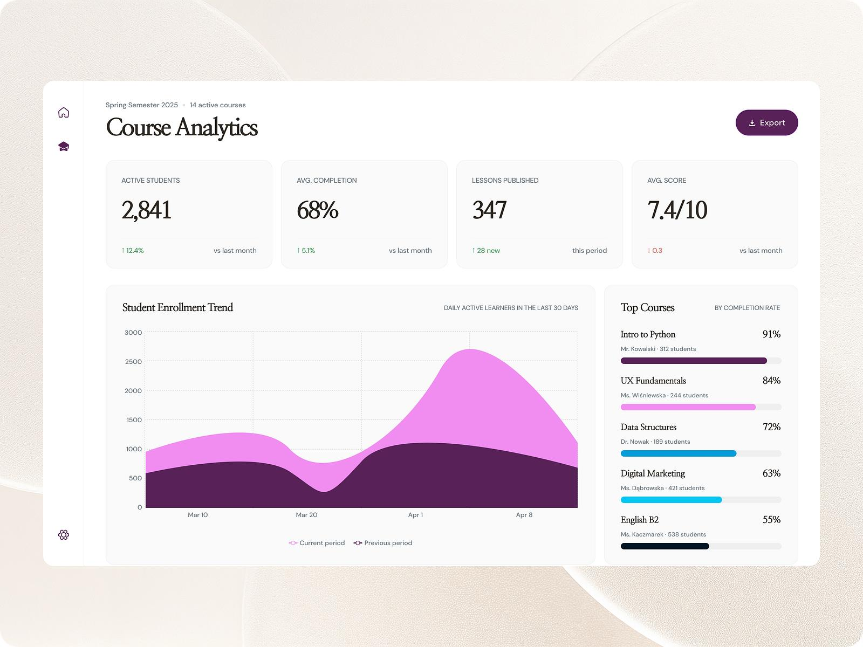
Project Objectives
Manage courses, learners, and enrolment records.
Record learner activities and completion status.
Calculate course-wise and overall completion rates.
Analyse weekly learning activity trends.
Identify enrolments with no recent activity.
Compare the performance of different courses.
Generate charts and downloadable analytical reports.
Main objective: Support better monitoring and data-driven decision-making in e-learning.

Slide 5
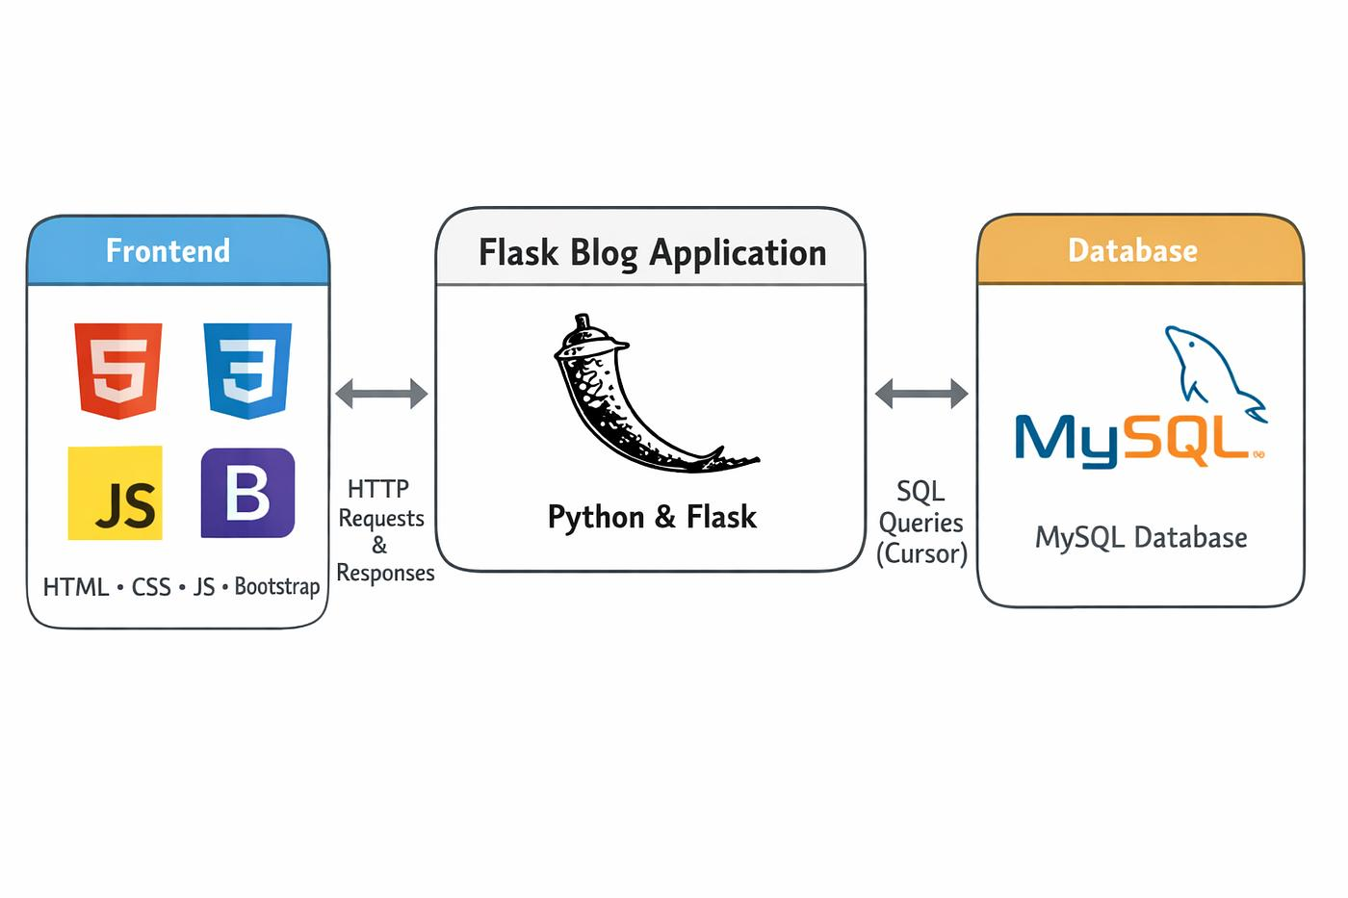
Proposed Solution
Proposed features:
A centralized dashboard for course and enrolment statistics.
Course, learner, and enrolment management.
Learning activity tracking.
Interactive charts for course comparisons.
Weekly activity summaries.
Automatic identification of inactive enrolments.
CSV reports for further analysis.
Expected benefit: Administrators can understand learning performance more quickly without manually calculating every statistic.

Slide 6
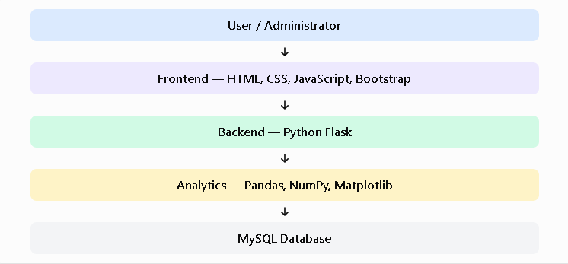
retrieves data from MySQL, performs analytics, and displays results on the dashboard.
System Architecture
User / Administrator: Manages courses and views reports.
Frontend: Provides the user interface using HTML, CSS, JavaScript, and Bootstrap.
Backend: Python Flask handles requests and application logic.
Analytics: Pandas, NumPy, and Matplotlib analyse data and generate charts.
MySQL Database: Stores courses, learners, enrolments, and activity records.
Working Process: The frontend sends requests to Flask, which retrieves data from MySQL, performs analytics, and displays results on the dashboard.

Slide 7
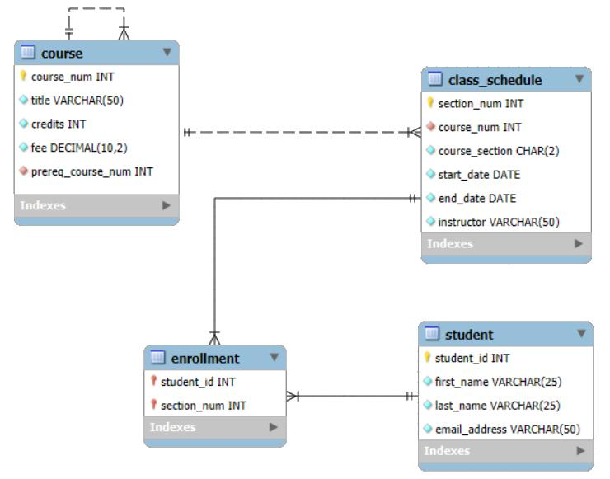
Database Design
Table |  |  | Purpose
courses |  |  | Stores course names and categories
learners |  |  | Stores learner IDs and roll numbers
Enrolments |  |  | Links learners to courses and stores enrollment status
activities |  |  | Stores activity dates, types, and completion status

Slide 8
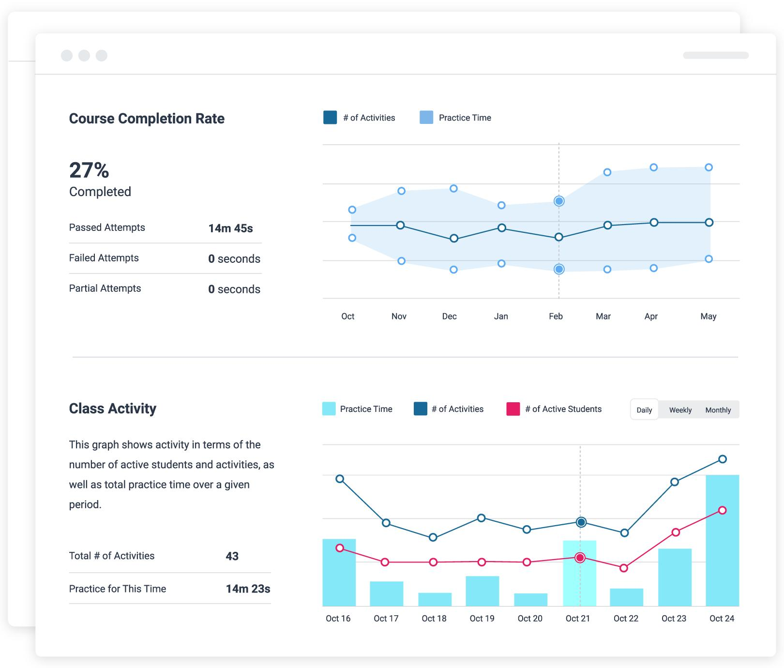
Analytics and Calculations
1. Course completion rate
(Completed Enrol/total Enrol)x100
2. Weekly activity analysis
Group activity records by calendar week.
Count activities and examine trends over time.
3. Inactive enrolment detection
- Flag enrolments that are not completed and have no recorded activity or whose latest activity is more than 14 days old.
4. Course comparison
Compare total enrolments, completed enrolments, and completion percentages.
Tools: Pandas for data grouping, NumPy for numerical calculations, and Matplotlib/Chart.js for visualization.

Slide 9

Implementation Plan
Requirement Analysis: Identify features and data requirements.
Database Design: Create tables and relationships in MySQL.
Backend Development: Build Flask routes and database connectivity.
Frontend Development: Build dashboard pages and forms.
Analytics Development: Implement calculations and charts.
Integration: Connect the frontend, Flask backend, and MySQL.
Testing: Verify calculations, CRUD operations, reports, and error handling.
Development environment: Visual Studio Code, Python, MySQL Workbench, and a web browser.

Slide 10
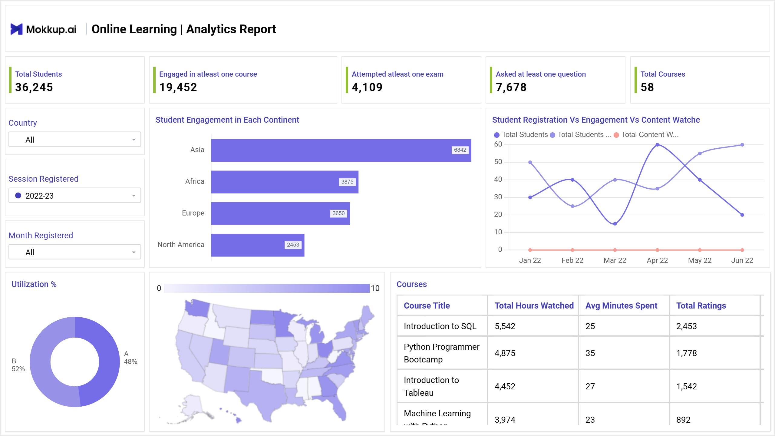
Expected Outcomes
A centralized view of courses and enrolments.
Faster calculation of course completion rates.
Clear visualization of weekly learning activity.
Easier identification of inactive enrolments.
Better comparison of course performance.
Downloadable reports for analysis.
Improved visibility into learning progress.
Expected deliverables: A responsive web dashboard, MySQL database, Flask backend, analytics module, charts, and CSV reports.

Slide 11

Conclusion
The E-Learning Course Analytics System aims to transform course enrolment and learner activity records into useful insights. By combining Flask, MySQL, Pandas, NumPy, and data visualization, the proposed application will help administrators monitor course performance and identify inactive enrolments.

Slide 12


